Slide 1
EF01: Macroeconomics
Sources of Fluctuations

Slide 2
Program
This Session: sources of fluctations
Derive Equilibrium
Aggregate Demand Shock
Short term
Dynamics
Aggregate Supply Shock
This is a recap session. Make sure you follow the overal approach and work on the intuitions.
Sessions Program:
Refresher and Introduction to AS/AD
Aggregate Demand
Aggregate Supply
Sources of Fluctations and Exercises
Monetary Policy
Open Economy

Slide 3
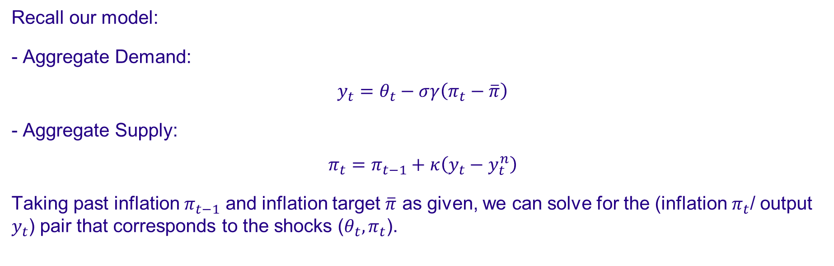
AS/AD Equilibrium
Recall our model:
- Aggregate Demand:
$$y_{t}=θ_{t}−σγ\left(π_{t}−\overline{π}\right)$$
- Aggregate Supply:
$$π_{t}=π_{t−1}+κ\left(y_{t}−y_{t}^{n}\right)$$
Taking past inflation $π_{t−1}$ and inflation target $\overline{π}$ as given, we can solve for the (inflation $π_{t}$/ output $y_{t}$) pair that corresponds to the shocks ($θ_{t},π_{t}$).

Slide 4
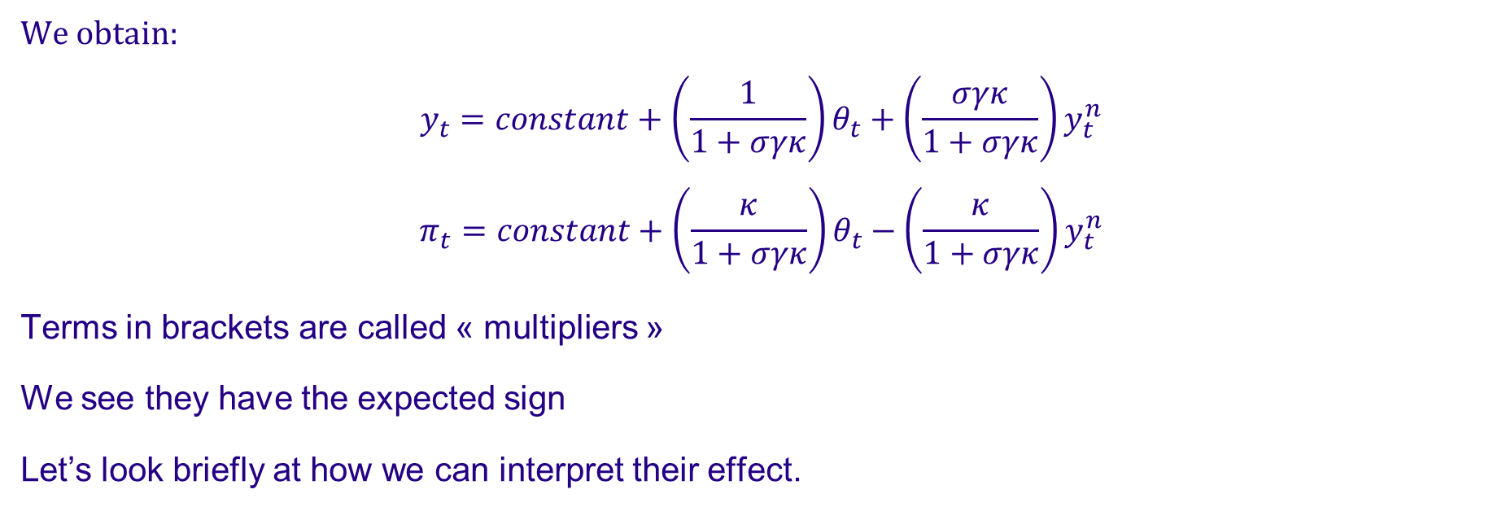
Short-Term Effect of Shocks
We obtain:
$$y_{t}=constant+\left(\frac{1}{1+σγκ}\right)θ_{t}+\left(\frac{σγκ}{1+σγκ}\right)y_{t}^{n}$$
$$π_{t}=constant+\left(\frac{κ}{1+σγκ}\right)θ_{t}−\left(\frac{κ}{1+σγκ}\right)y_{t}^{n}$$
Terms in brackets are called « multipliers »
We see they have the expected sign
Let’s look briefly at how we can interpret their effect.

Slide 5
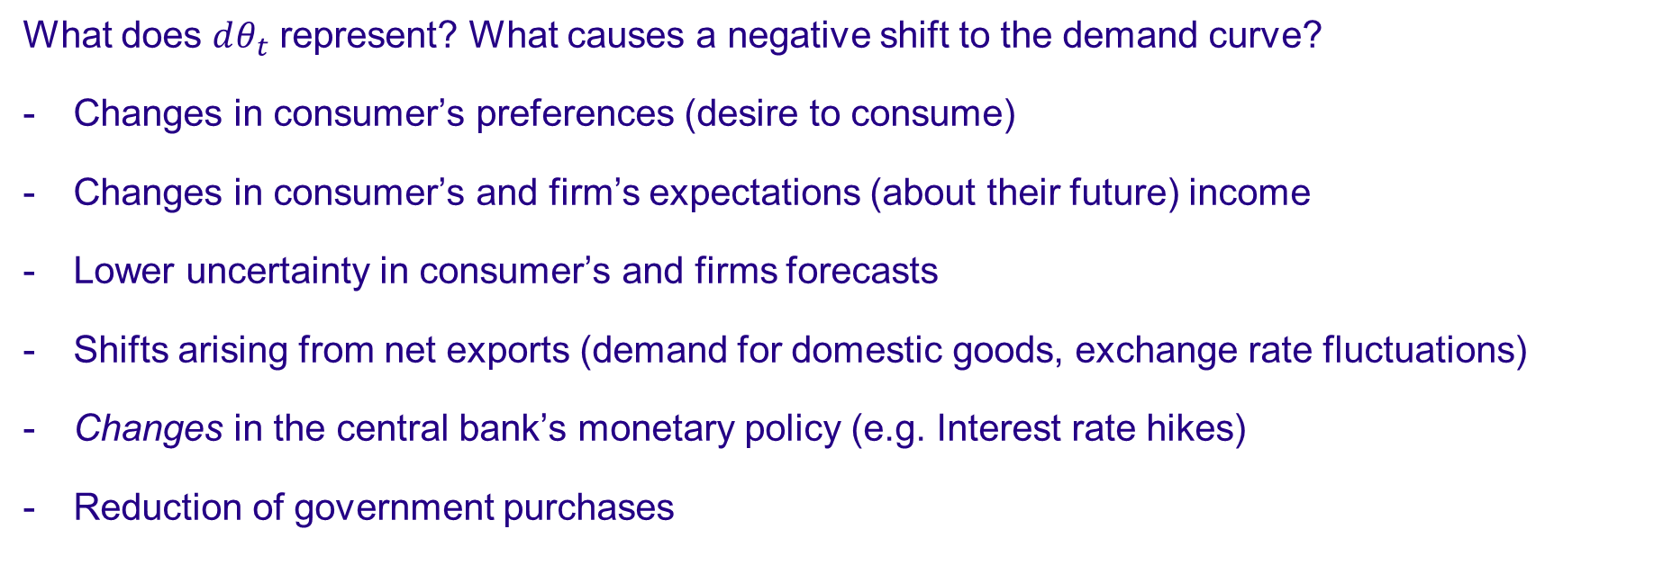
Demand Shock
What does $dθ_{t}$ represent? What causes a negative shift to the demand curve?
Changes in consumer’s preferences (desire to consume)
Changes in consumer’s and firm’s expectations (about their future) income
Lower uncertainty in consumer’s and firms forecasts
Shifts arising from net exports (demand for domestic goods, exchange rate fluctuations)
Changes in the central bank’s monetary policy (e.g. Interest rate hikes)
Reduction of government purchases

Slide 6
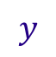
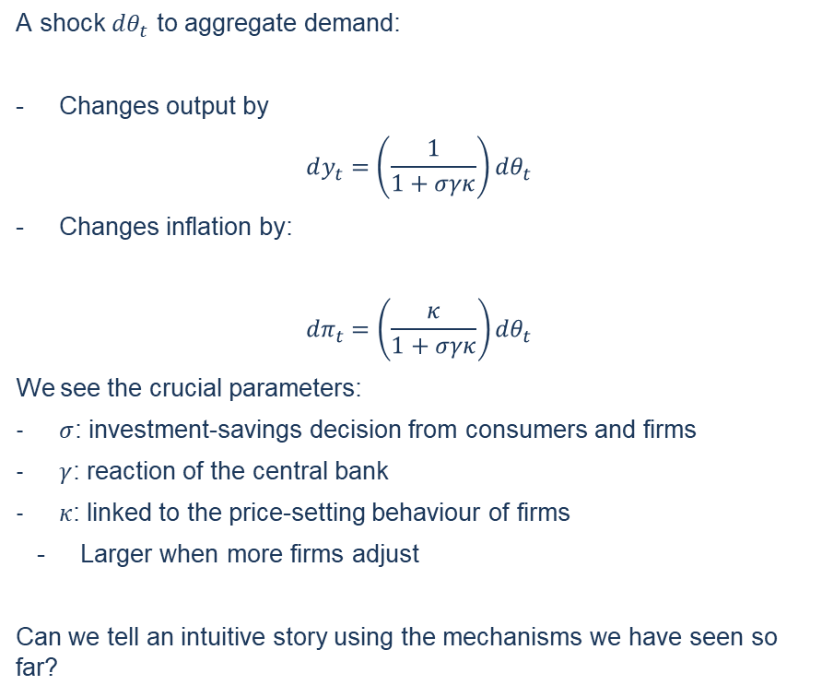
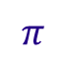
Demand Shock
A shock $dθ_{t}$ to aggregate demand:
Changes output by
$$dy_{t}=\left(\frac{1}{1+σγκ}\right){dθ}_{t}$$
Changes inflation by:
$${dπ}_{t}=\left(\frac{κ}{1+σγκ}\right){dθ}_{t}$$
We see the crucial parameters:
$σ$: investment-savings decision from consumers and firms
$γ$: reaction of the central bank
$κ$: linked to the price-setting behaviour of firms
Larger when more firms adjust
Can we tell an intuitive story using the mechanisms we have seen so far?
$$π$$
AD
AS
$$y$$

Slide 7
Demand Shock
Theoretical Impact: Short Run
Can we describe intuitively what happens? (try it at home)
Increased aggregate demand for goods…
Increases production…
Which increases demand for labour…
Which drives real wages up (because labour supply is not perfectly elastic)
Which increases production real costs…
Which is translates into price inflation (but not 1 to 1 because not all firms adjust)
Increased prices discourage demand, which partially compensate for production increase.

Slide 8

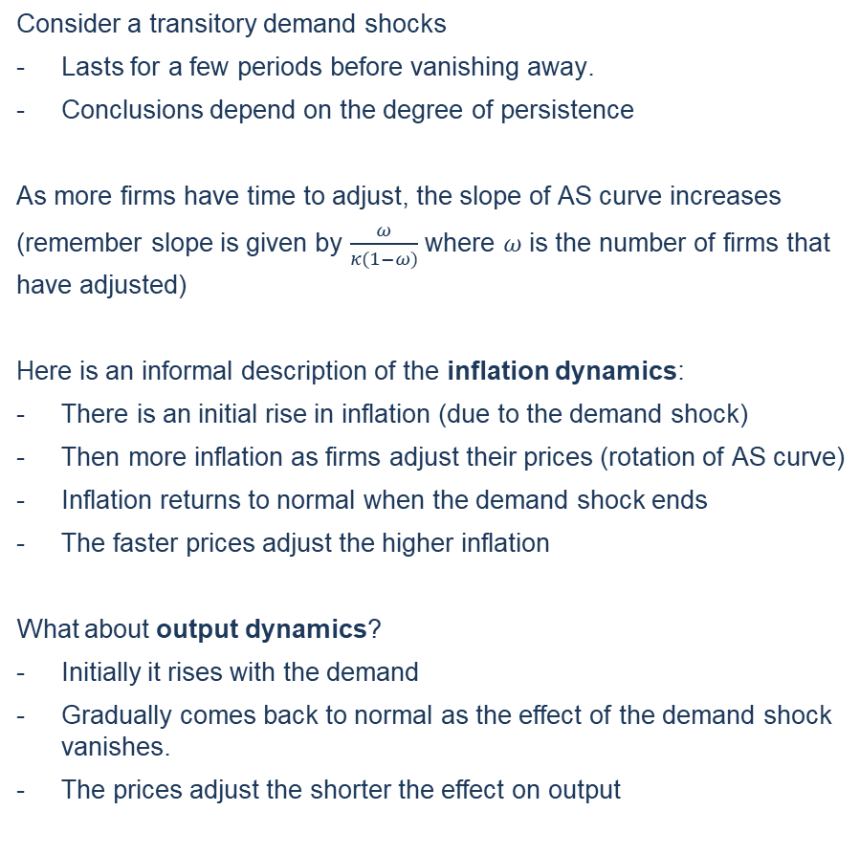
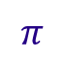
Demand Shock
Consider a transitory demand shocks
Lasts for a few periods before vanishing away.
Conclusions depend on the degree of persistence
As more firms have time to adjust, the slope of AS curve increases
(remember slope is given by $\frac{ω}{κ(1−ω)}$ where $ω$ is the number of firms that have adjusted)
Here is an informal description of the inflation dynamics:
There is an initial rise in inflation (due to the demand shock)
Then more inflation as firms adjust their prices (rotation of AS curve)
Inflation returns to normal when the demand shock ends
The faster prices adjust the higher inflation
What about output dynamics?
Initially it rises with the demand
Gradually comes back to normal as the effect of the demand shock vanishes.
The prices adjust the shorter the effect on output
Theoretical Impact: Dynamics
$$π$$
More firms
adjust
AD
Demand Shock
AS
$$y$$

Slide 9
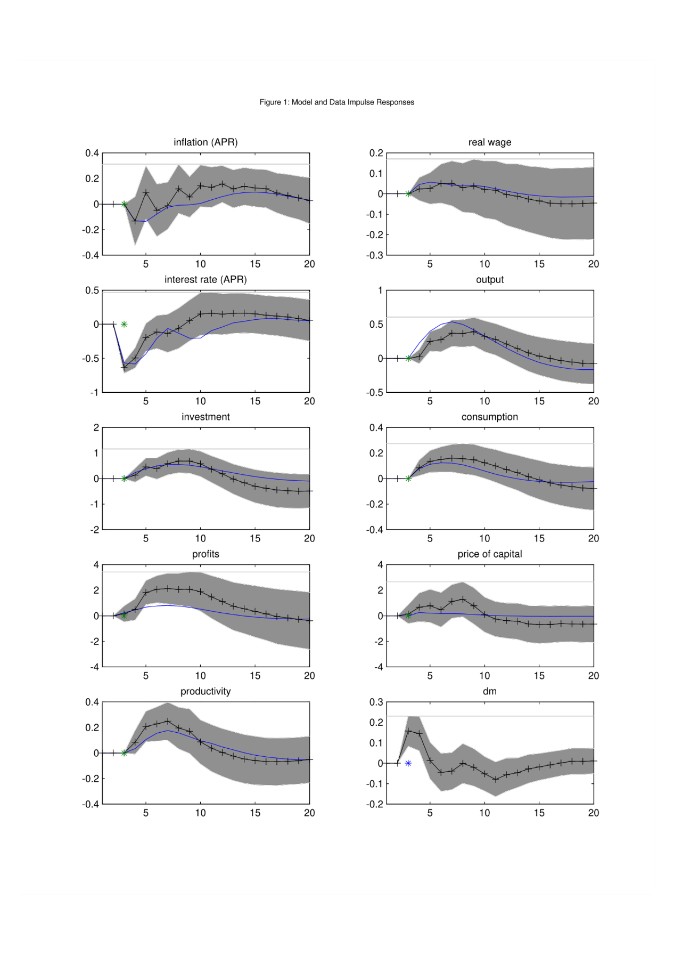
Demand Shock: Empirical Check
Graph shows the effect of a “pure” demand shock:
unexpected monetary policy shock
It compares response of economic variables:
In the data (econometrics: VAR estimate)
In a model with nominal rigidities (DSGE modeling)
Both look rather similar
Compare with our model
Investment and consumption increase
Inflation increases over the medium run (not just on impact)
Real wage increases
Output increase is persistent
But then there is capital which smoothers production over time.

Slide 10
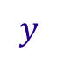
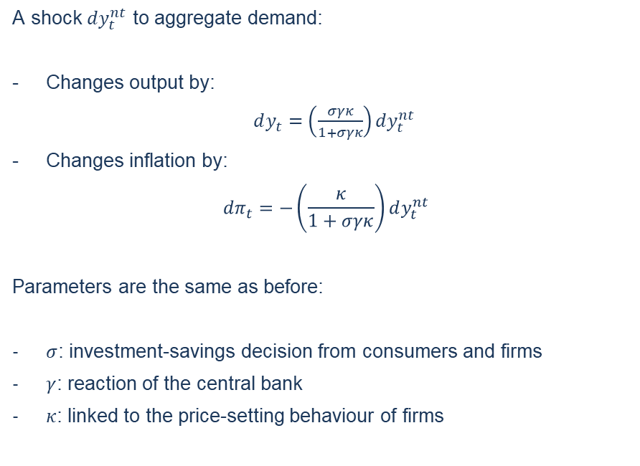

Supply Shock
Theoretical Impact
$$π$$
A shock $dy_{t}^{nt}$ to aggregate demand:
Changes output by:
$dy_{t}=\left(\frac{σγκ}{1+σγκ}\right)dy_{t}^{nt}$
Changes inflation by:
$${dπ}_{t}=−\left(\frac{κ}{1+σγκ}\right)dy_{t}^{nt}$$
Parameters are the same as before:
$σ$: investment-savings decision from consumers and firms
$γ$: reaction of the central bank
$κ$: linked to the price-setting behaviour of firms
AD
AS
$$y$$

Slide 11
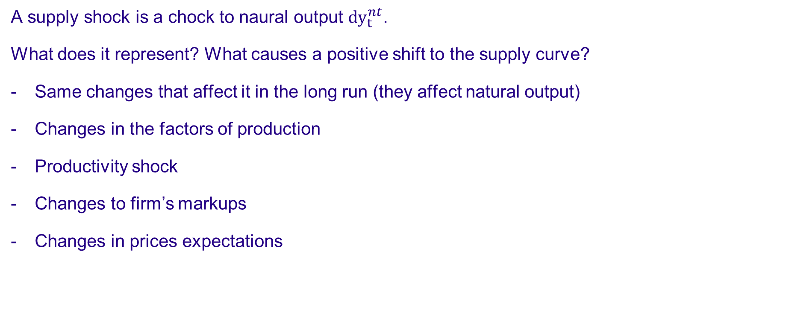
Supply
A supply shock is a chock to naural output ${dy}_{t}^{nt}$.
What does it represent? What causes a positive shift to the supply curve?
Same changes that affect it in the long run (they affect natural output)
Changes in the factors of production
Productivity shock
Changes to firm’s markups
Changes in prices expectations

Slide 12
Supply Shock
As negative supply shock shifts the AS curve to the left
Higher inflation
Lower output
How can governement and central bank mitigate the shock?
- They can’t quickly act on supply
The central bank’s reaction is already in the AD curve
It makes demand react more on inflation (more horizontal)
MP curve assumed it cares only about inflation
... so we don’t have a good framework to look at CB’s reaction
The government can stimulate demand to counteract the supply shock
With fiscal policies
But this works only in the short term
... And raises a few questions (is it efficient? where does money comes from?)
... More on this later
Stabilization Policy
$$π$$
AD
Supply
shock
AS
Stabilization
$$y$$

Slide 13
Main Takeaways
After our model, in the short term:
(positive) Demand shocks imply a rise in inflation and an increase in output
(positive) Supply shocks imply a decrease in inflation and an increase in output
After a lasting demand shock
As prices adjust, initial output increase is reversed
When demand falls back to normal, inflation comes back to natural level
Real world dynamics also feature lags between reactions of output and inflation
Monetary and fiscal policy can reverse demand shocks in the short term
Supply shocks can’t be directly conteracted but..
Demand policies can accomodate them in the short term (until prices adjust)

